Slide 1

Python Programming Bootcamp - Week 3, Day 3
Tuples and Dictionaries – Introduction and Operations
Atta Muhammad
attapanhyar@quest.edu.pk
+923331971110
Quaid-e-Awam University of Engineering, Science and Technology

Slide 2
Learning Objectives
Understand tuples and their immutability.
Learn basic operations on tuples and their use cases.
Understand dictionaries, key-value pairs, and operations on dictionaries.
Explore practical applications of tuples and dictionaries in Python programming.

Slide 3

Introduction to Tuples
Definition: A tuple is an immutable, ordered sequence of items.
Example:

Slide 4

Accessing Tuple Elements
Indexing: Tuples use zero-based indexing, similar to lists.

Slide 5
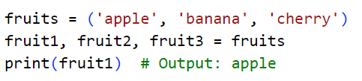
Tuple Unpacking
Definition: You can assign values from a tuple to variables in a single line.

Slide 6

Tuples are Immutable
Explanation: Once a tuple is created, you cannot modify its elements.

Slide 7
When to Use Tuples
Use Cases:
Use tuples when you need an ordered collection that should not be changed.
Tuples are often used to return multiple values from a function.

Slide 8
Hands-On Exercise 1
Task: Create a tuple with the names of 5 cities and print the third city.

Slide 9
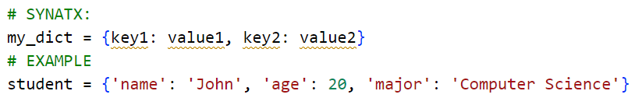
Introduction to Dictionaries
Definition: A dictionary is a collection of key-value pairs, where each key is unique.

Slide 10
Accessing Dictionary Values
Using Keys:

Slide 11

Modifying a Dictionary
Adding/Updating Values

Slide 12

Removing Items from a Dictionary
Using del and pop():

Slide 13

Looping Through a Dictionary
Keys, Values, and Items:

Slide 14
Hands-On Exercise 2
Task: Write a Python program to create a dictionary with details of a book (title, author, year). Add a new key for the genre and print all the details.

Slide 15
Dictionary Methods
Common Methods:
get(), update(), keys(), values(), items()

Slide 16
Hands-On Group Activity
Task: Create a dictionary representing a classroom. The keys are the student names, and the values are their grades. Use loops to calculate the average grade.

Slide 17
Recap and Key Takeaways
Key Points:
Tuples are immutable sequences of items, while dictionaries are mutable collections of key-value pairs.
Tuples are ideal for ordered, fixed data, while dictionaries are used for fast lookups and organizing data by keys.

Slide 18
Q&A and Wrap-Up

Slide 19
MATCH THE SOLUTION 😒

Slide 20
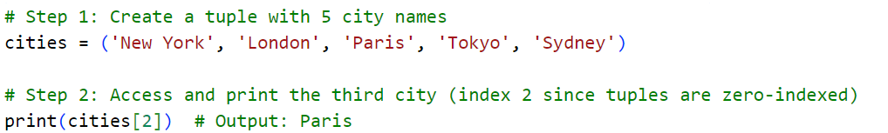
EXERCISE 🤐

Slide 21
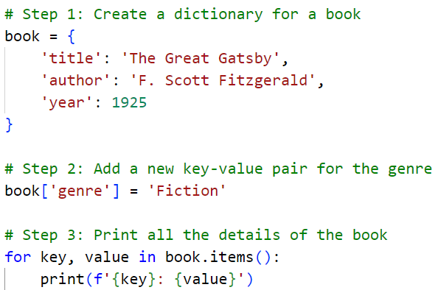
EXERCISE 😂

Slide 22
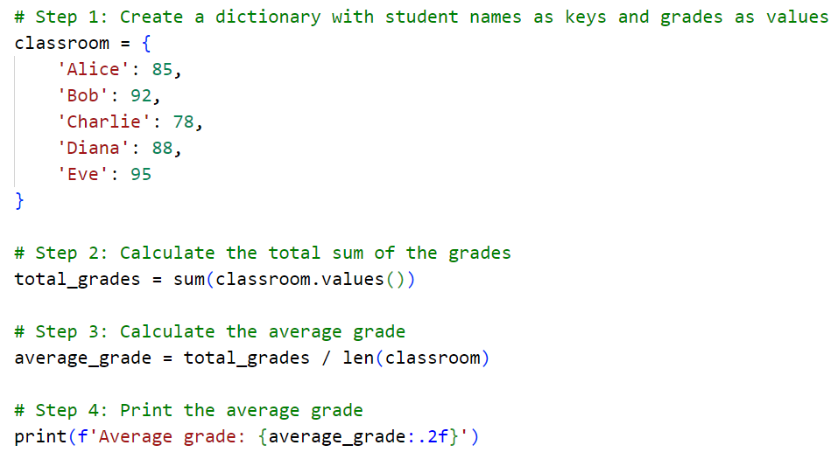
EXERCISE 😊

